Slide 1

Record Vote
Revolutionizing bill tracking with ease.
2023

Slide 2


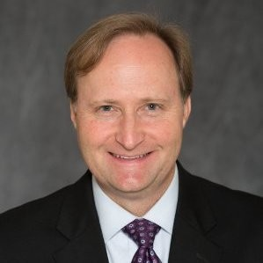
The Record Vote team
Andrew Cates
Ben Melson
Robert Haney
Chief Executive Officer
Chief Operations Officer
Chief Strategy Officer

Slide 3
Vision Mission
Mission
Vision
Empower people and organizations to effectively track, manage, and influence policy, regulatory and decision-making processes at the local and state government level from anywhere in the world with their mobile device.
Establish Record Vote as the global leader in advanced mobile technology applications that revolutionize the way people interact with their local and state governments.

Slide 4
Problem
Currently available software solutions are either outdated (Telicon) or too broad (Fiscal Note, Quorum, etc..) to meet the specific needs of Texans and those who work in the legislative space or have a vested interest in policies and regulations.
Our goal is to fill this technology gap and provide Texans with a modern, user-friendly tool that keeps them informed and empowered to influence.

Slide 5
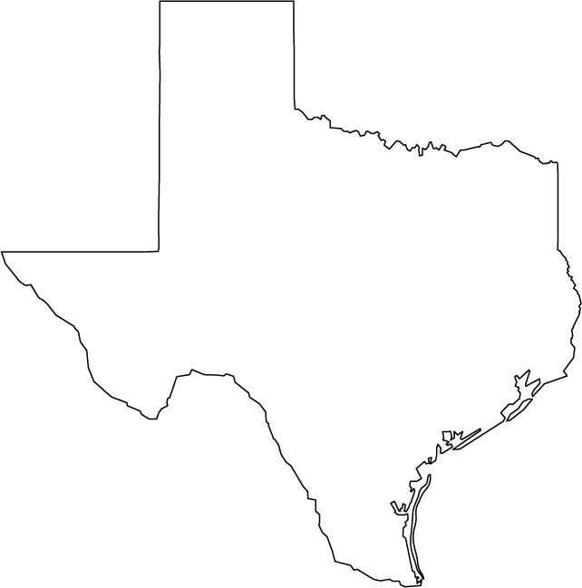
Market Opportunity
450 - public/private colleges & universities
250 - stakeholder/business lobby days at the capitol
5,000+ registered lobbyists representing over 20,000 businesses & organizations
110,000 nonprofits = $217B in expenditures & $110B toward TX GDP
4,700+ business and industry associations
4,000 Trade/Professional associations and Chambers of Commerce
517 - For-profit, state, and non-profit hospitals
1,221 -Active municipalities, including 970 cities, 228 towns, and 23 villages
1,000+ public school districts and charter schools
29.5 Million - Texans
Notes:
The potential market for Record Vote is enormous, with millions of Texans seeking reliable and user-friendly tools to stay informed and engaged in the democratic process. Our initial customers will be the “capitol crowd.” The people who’s business it is to participate and influence the legislative process and who represent the interests of public, private, and government organizations.
The Texas Capitol is a hub of legislative and regulatory activity, with hundreds of bills and rules introduced each year. Our platform addresses a specific need that is currently unmet by the existing software solutions in the market.
With our focus on the Texas market, we are uniquely positioned to capture a significant share of this growing market and become the go-to tool for Texans who want to stay informed and engaged.

Slide 6

Revolutionizing Bill Tracking in Texas
Our mobile-first bill tracking experience provides a simple and intuitive user interface that is specifically designed for tracking bills and regulatory rulemaking at the Texas Capitol.
Features such as drag-and-drop functionality, push notifications for bill alerts, and state agency rulemaking tracking, our platform is the most comprehensive and user-friendly solution available.
Our subscription-based service provides exclusive content and features to our users, ensuring that they have access to the latest information and insights on the issues that matter most to them.
Streamlined bill tracking
Efficient search tools for legislation, state statutes, legislative rules and agency rulemaking
Legislative staff contact list
Push notifications for every step of the process
Historical and live data
Live news feed related to your tracked legislation
Team and Client communication and sharing
Custom user dashboard widgets
Pain points being solved
Outdated Technology, Inaccessibility
Notes:
It’s important to us, and I believe I speak for the entire team here, that we do not take the word revolutionizing lightly. Beyond bringing the highest quality product to market (arguably the most quality product on the market in the country), we strongly believe that this tool will change the way lobbying is done in Texas. We believe that an investment in the development of this product will open the doors for more individuals and organizations to enter the market (ease of use, accessibility, affordability, responsiveness to customers and demand) and it could change the very way our state legislature operates. This is something that if done properly in early development phases will forever change Texas politics and endure the test of time.

Slide 7
The Solution
Business model highlights:
Individual User | $100/month
Additional License | $50/month
Unlimited Licenses | $30,000/biennium
Public | Free
1. Subscription-based revenue model
2. Access to advanced mobile technology with exclusive content and add-on features that advance with SaaS technology offerings
3. Advertisement partnerships and affiliate marketing programs associated with public product
4. Sustainable and scalable revenue generation at local government level and across the country
Notes:
Record Vote's business model is simple and effective:
We generate revenue through our subscription-based service, which provides our users with access to exclusive content and features.
Our subscription plans are designed to meet the needs of a wide range of users, from individuals to businesses and organizations. In addition, we plan to explore othr revenue streams, such as advertising partnerships and affiliate marketing programs through our free public software.
Our goal is to provide a valuable service to our users while also generating sustainable revenue for our company.

Slide 8
Future Development
Lobby Days
Ground Game
Event management software add-on
1. Software service for large groups, associations, non-profits, chambers of commerce
2. Mobile automated registration
3. Automated meeting scheduling to match attendee to legislators
4. Event communications and training all in one place
Email advocacy and campaign software
1. Member focused communications on legislation and regulatory action
2. Grass roots campaign tools to increase engagement
3. Track member engagement and priorities to adjust messaging and increase impact

Slide 9
Future Development Ideas
Lobby Activity Reporting
Point of Order Scraping
Telling story of ROI on work accomplished
1. Product generated report to clients
2. Dropdown menu options
3. Schedule meeting, phone call, video call
4. Record staff and member meetings
5. Summarize meetings and outcomes of legislation
AI scraping and report of potential POO
1. Upload up-to-date House and Senate rules
2. Run legislation of interest against rules
3. Generate report of potential POO and reference rule in violation
4. Downloadable and shareable

Slide 10
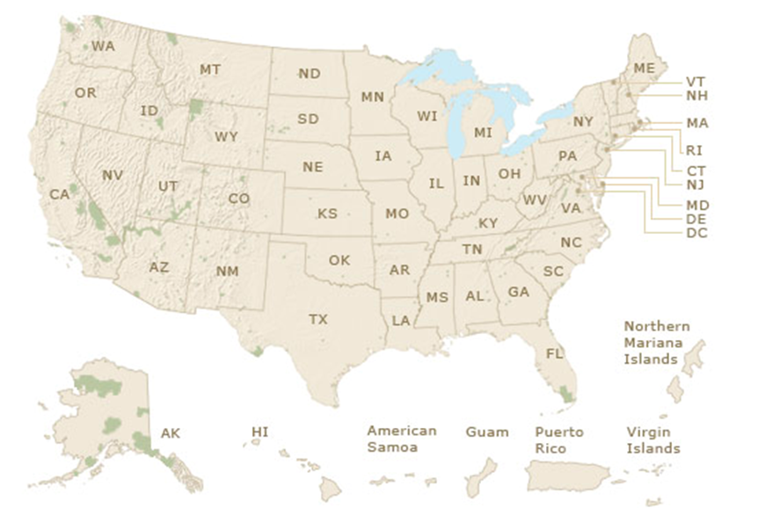

Our scalable solution
🤝
Business model highlights
Focusing on launching in home state of TX first, and with the right team and investment, we can scale to multiple states.
Virginia - 2,800 lobbyists retained by 1,200 clients (incl. 500 companies, 300 trade associations, 175 labor orgs, 125 local govts)
Colorado- Nearly $44 million was spent on lobbying during the 2020-21 fiscal year
California - Employers spent about $444 million on lobbying state officials in California last year, up by nearly $50 million, or 12%, from 2021

Slide 11
Ecosystem & Competition

Slide 12







Competitive landscape
Modern Tech
National Focus
Texas Focus
Outdated Tech
Notes:
Fiscal Note & Quorum are the most likely to acquire competitors. National/Global scope

Slide 13
Why we're better than
User Friendly and Modern Interface
Streamlined Bill Tracking & Search Features
Legislative Staff Contact List
Live News Feed
Team and Client Communication Tools
Custom Dashboard Widgets

Slide 14
Investment

Slide 15
We are looking for…
A partner, with
$1M USD to
Grit, passion and expertise within our landscape
1. Strategic vision and experience.
2. Passion for innovation and technology.
3. Willingness to overhaul current industry and establish a lasting legacy in Texas politics.
4. Strong network and industry connections.
Launch and expand the product across teams & build foundation for scalability
1. Product development.
2. Marketing and user acquisition.
3. Partnerships and collaborations.
4. Team expansion.

Slide 16
Profit & Loss Statement
🤝
Investment highlights
1. $1 Million initial investment
2. $350,000 MVP development cost
3. $10,140 year over year scraping and hosting costs (varies based on amount of data processing)

Slide 17
Profit & Loss Statement
🤝
Subscription Fees and Targets
Assumptions: Telicon average cost for single subscription = $166.67/mo (biennium contract)
250 subscribers in 2025 session, drop to 150 subscriber for remainder of 2025 interim (Does not include potential state agency customers or others with multiple extra licenses at additional $50/ea/mo)
2 options:
$250/mo session + $150/mo interim = $600,000 revenue session years = $270,000 revenue interim years
$50/mo all year = $150,000/yr (biennial contract required)
Notes:
Option 1 - If you want to start receiving residuals ASAP - we will need to be aggressive in sales/marketing due to the price point - comparable to Telicon. Assumes higher investment in sales/marketing and less potential for reinvestment for upgrades, expansion opportunities.
Option 2 - Undercut Telicon drastically (by >200%) to grab market share/more subscribers immediately and try to drive Telicon out, then add additional fees for new features and add advertising revenue.

Slide 18
Exit Strategy Options for Investor
Short term: Repayment
Long term: Acquisition Target
Lower equity
Timeline for repayment of investment with interest
Investment in idea of the product/business itself
Higher equity
Allow us to reinvest net profits back into the company, take calculated risks to grow exponentially
Investment in founders to grow the company

Slide 19
Join Our Mission
Thank you for considering Record Vote for your investment portfolio. We believe that our platform has the potential to revolutionize the way Texans stay informed and engaged in the democratic process. We invite you to join us on our mission to create a more informed and empowered Texas. To learn more about our platform, please schedule a demo with our team. We look forward to partnering with you to achieve our shared goals.

Slide 20
Let’s talk business
Email
andrew@andrewcates.com
Phone
512-426-4593
Andrew Cates
Founder
Record Vote

Slide 21
SaaS Market Insight
The global software as a service market size is expected to reach USD 819.23 billion by 2030, growing at a CAGR of 13.7% from 2023 to 2030.
The rising trend towards mobile applications such as emails, video calls, and instant messaging further increases the usage of smart devices which further encourages the demand for software as a service (SaaS) during the forecast period.
The software segment led the market in 2022, accounting for over 84% share of the global revenue owing to a rise in the demand for cloud-based software outsourcing and an increase in the number of SMEs outsourcing
The private cloud segment held the largest revenue share of over 44% in 2022. Private clouds combine many advantages of cloud computing, such as ease of service delivery, scalability, security, elasticity, and resource personalization of on-premises infrastructure
The large enterprises segment led the market in 2022, accounting for over 60% share of the global revenue. SaaS gives enterprises greater visibility and control over their cloud environments, allowing them to manage risk and compliance requirements better
North America accounted for the largest share of over 44% of the global SaaS market. Software as a Service (SaaS) is a rapidly growing industry in North America, with many developments emerging in recent years. Cloud-based software solutions have become increasingly popular in North America due to their scalability, cost-effectiveness, and ease of use
Notes:
“Wealth in and of itself is not problematic. It is how rich people convert financial might into political power for their own benefit that creates problems.”

